Slide 1
Front-End Developer 18 – 21.03.2018
Radovan Ostojić

Slide 2
Sadržaj časa
HTML
DOM manipulation – nastavak
CSS Flexbox

Slide 3

Ponavljanje je majka znanja ☺
<table>
<td>
<th>
<tr>
rowspan
colspan
Nacini da se event doda na HTML element

Slide 4
HTML
DOM manipulation

Slide 5

Primer sa insertBefore
<!DOCTYPE html>
<html>
<head>
<meta charset="utf-8">
<title>Javascript Essentials</title>
</head>
<body>
<div id="yellow" style="background:yellow; width:200px; height:20px;"></div>
<div id="green" style="background:green; width:200px; height:20px;"></div>
<script src="myapp.js"></script>
</body>
</html>

Slide 6
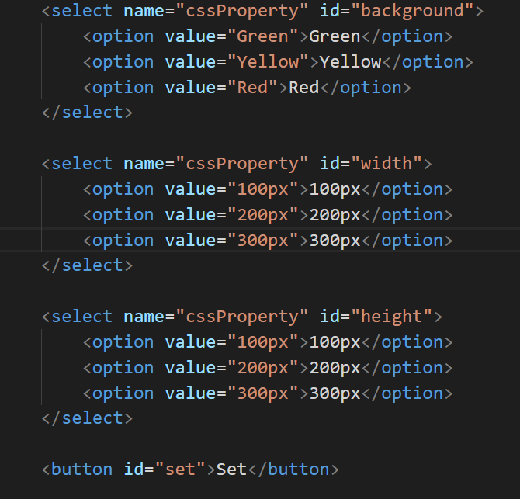
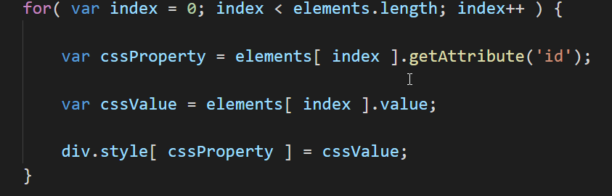
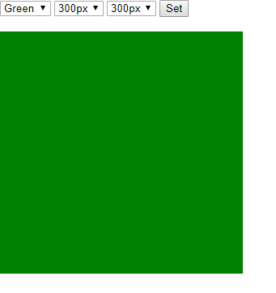
Primer sa nizom kontrola

Slide 7
Flex Box

Slide 8
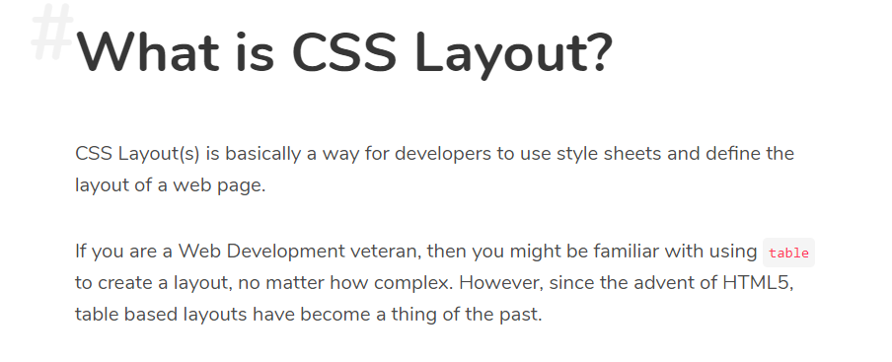

Slide 9
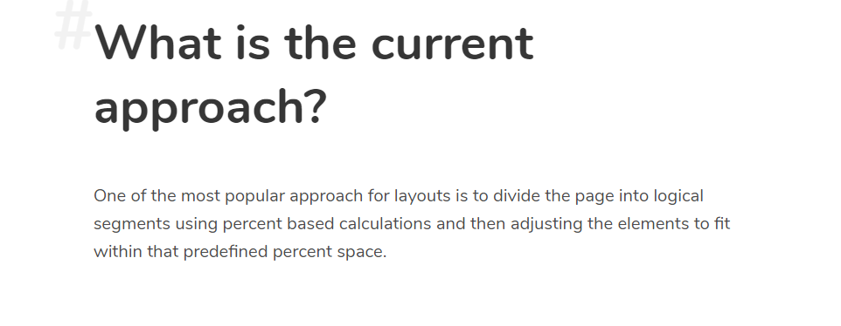

Slide 10
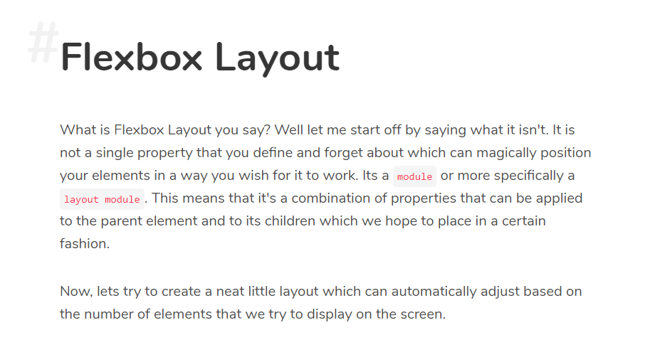

Slide 11
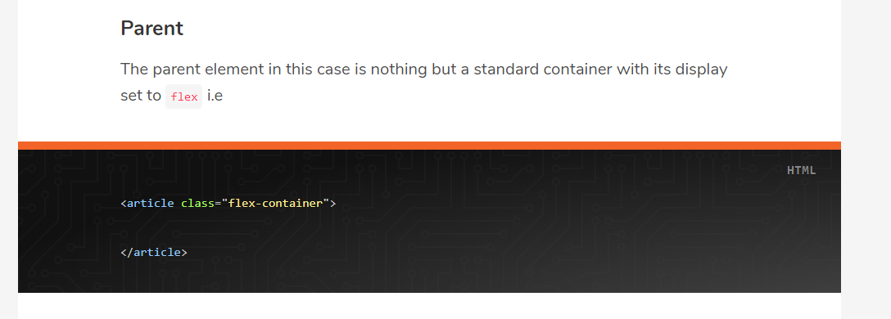
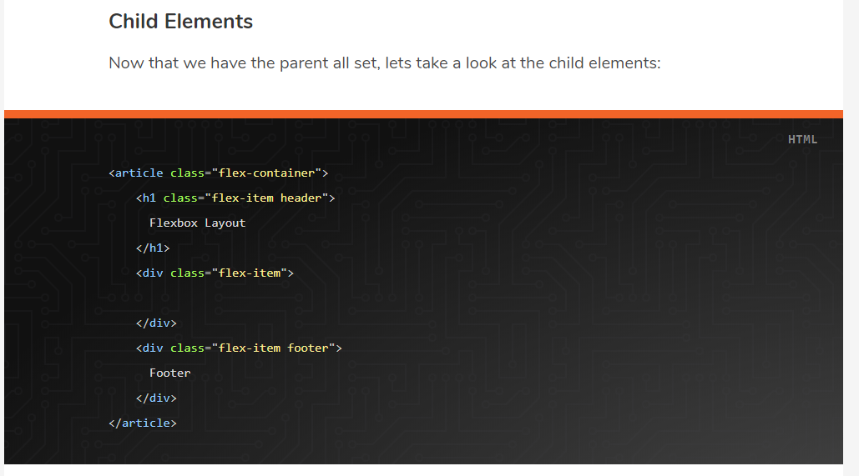

Slide 12
Layouts of the Future - Flexbox Layout
https://scotch.io/@kashyapmukkamala/layouts-of-the-future-flexbox-layout#comments-section

Slide 13
Coding challenge
Napisati JavaScript program koji iz select liste bira jednu od tri zemlje:
Srbija
Japan
Brazil
Nakon izbora zemlje, klikom na dugme “Prikazi zastavu”, prikazati zastavu u posebnom img tagu.

